Slide 1
Ch04 Common Built-in Data Types
Highlights of the chapter:
4.1 Overview of Python's Built-in Data Types
4.2 int data type (arbitrary precision integer)
4.3 The float type (finite-precision floating-point number)
4.4 The bool data type
4.5 Complex types
4.6 Conditional Expressions, Relational Operators, and Logical Operators
4.7 Arithmetic and Bitwise Operators
4.8 Mixed Operations and Numeric Type Conversion
4.9 Built-in standard math functions
4.10 math module and math functions
4.11 The random module and random functions
4.12 Examples of integrated applications

Slide 2
Overview of Python's Built-in Data Types
In Python, everything is an object, and every object belongs to a certain data type
Python's data types include built-in data types, data types defined in modules, and user-defined types
Numeric data types: int, bool, float, complex
Sequential data types: immutable (str, tuple, bytes) and mutable (list, bytearray)
Set data types: set, frozenset
Dictionary data type: dict. e.g. {1: "one", 2: "two"}
NoneType, NotImplementedType and EllipsisType

Slide 3
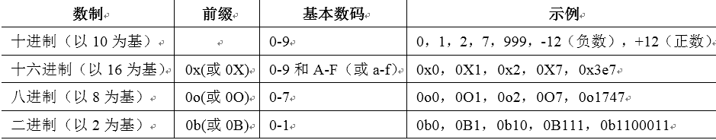
int type (arbitrary precision integer) (1)
Integer literal: numeric string (can be preceded by a negative sign -)
[Example 4.1] Example of Integer Literals
Starting with Python version 3.7, underscores are supported as a thousandths marker for integers or floating point numbers to enhance readability of large values. Binary, octal, and hexadecimal use underscores to differentiate between 4-bit notation
>>> a=123
>>> type(a) #Output: <class 'int'>
<class 'int'>
>>> 1_000_000_000_000_000_000 # Output: 1000000000000000
1000000000000000
>>> 0x_FF_FF_FF_FF # Output: 4294967295
4294967295

Slide 4
int type (arbitrary precision integer) (2)
Creating int objects
Example 4.2: Example of int object
Methods of the int object
Example 4.3] Example of int object method
>>> int # Output: <class 'int'>
>>> int(), int(123), int('456'), int(1.23) #Output: (0, 123, 456, 1)
>>> int('FF', 16), int('100', 2) # Output: (255, 4)
>>> int('abc') #Error reported. valueError: invalid literal for int() with base 10: 'abc'
>>> int(100, 2) #Error. TypeError: int() can't convert non-string with explicit base
>>> i = -10
>>> bin(i) # Convert the value to a binary string. Output: '-0b1010'
'-0b1010'
>>> i.bit_length(), int.bit_length(i) # Return the number of binary bits in i. Output: (4, 4)
(4, 4)

Slide 5
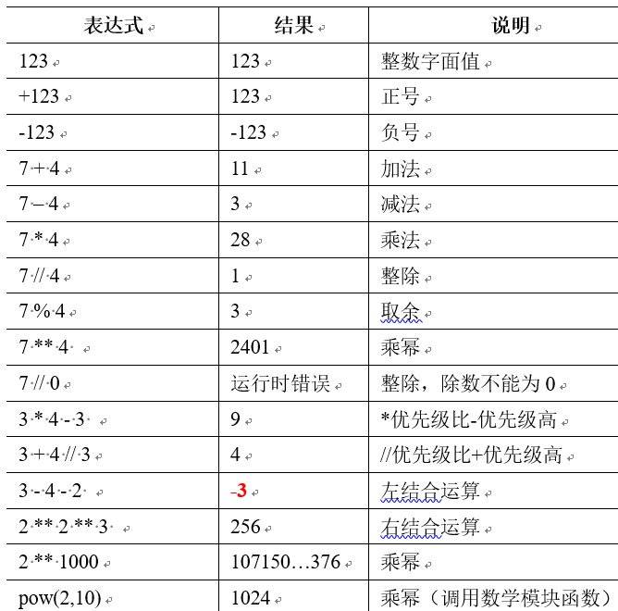
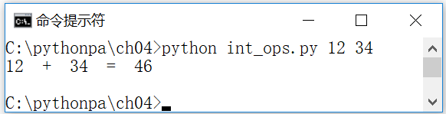
int type (arbitrary precision integer) (3)
Operations with Integers
Arithmetic operations, bitwise operations, built-in functions, math functions in math module
[Example 4.4] Example of integer arithmetic (int_ops.py)
import sys
a = int(sys.argv[1])
b = int(sys.argv[2])
sum = a + b
print(a, ' + ', b, ' = ', sum)

Slide 6
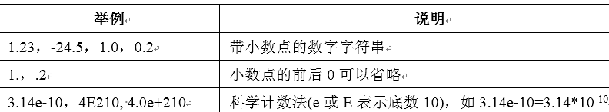
float type (finite-precision floating-point number)(1)
Floating point type constants
[Example 4.5] Example of Floating-Point Type Literals
Creating a float object
Example 4.6: Float Object Example
>>> 3.14 # Output: 3.14
3.14
>>> type(3.14) #Output: <class 'float'>
<class 'float'>
>>> float #Output: <class 'float'>
>>> float(123), float('3.14') #Output: (123.0, 3.14)
>>> float('Infinity'), float('-Infinity'), float('NaN') #Output: (inf, -inf, nan)
>>> float('123abc') #Error. ValueError: could not convert string to float: '123abc'

Slide 7
float type(finite precision floating point number)(2)
Methods for float objects
methodologies | clarification | typical example
as_integer_ratio() | Conversion to Fractions | 1.25.as_integer_ratio() #Result: (5, 4) float.as_integer_ratio(1.25) #result: (5, 4)
hex() | Convert to hexadecimal string | 12.3.hex() #Result: '0x1.89999999999999ap+3' float.hex(12.3) #result: '0x1.89999999999999ap+3'
fromhex(string) | Converting hexadecimal strings to floating point numbers | float.fromhex('0xFF') #Result: 255.0
is_integer() | Determine if the type is int | 3.14.is_integer() # Result: False float.is_integer(2.0) #Result: True

Slide 8
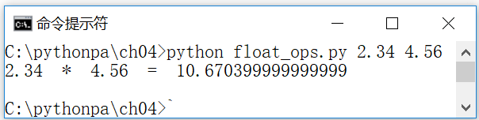
float type(finite precision floating point number)(3)
Floating-point arithmetic
Arithmetic operations, functions for floating-point operations in the math module
Example 4.7] Floating Point Arithmetic Example
import sys
a = float(sys.argv[1])
b = float(sys.argv[2])
c = a * b
print(a, ' * ', b, ' = ', c)

Slide 9
The bool data type and related operators
The bool data type contains two values
True (true) or False (false)
[Example 4.8] Example of Boolean Literals
Example 4.9: Example of a bool object
>>> True,False #Output: (True, False)
(True, False)
>>> type(True),type(False) #Output: (<class 'bool'>, <class 'bool'>)
(<class 'bool'>, <class 'bool'>)
>>> bool(0) # Output: False
False
>>> bool(1) # Output: True
True
>>> bool("abc") #Output: True
True

Slide 10
The bool data type and related operators
(1) Any Python expression can be evaluated as a Boolean logical value, so it can participate in logical operations. For example:
(2) C = A or B. If A is not 0 or not null or True, return A; otherwise return B. Calculate the second operand only if necessary, i.e., if A is not 0 or not null or True, don't calculate B. Short-circuit calculation. Short-circuit" calculations:
(3) C = A and B. If A is 0 or null or False, return A; otherwise, return B. Calculate the second operand only if necessary, i.e., if A is 0 or null or False, don't calculate B. i.e., "short-circuit" calculation. For example:
>>> not 0 # Output: True
>>> not 'a' #Output: False
>>> 1 or 2 # Output: 1
>>> 0 or 2 # Output: 2
>>> False or True #Output: True
>>> True or False #Output: True
>>> 1 and 2 # Output: 2
>>> 0 and 2 # Output: 0
>>> False and 2 # Output: False
>>> True and 2 # Output: 2

Slide 11
complex types (plural) (1)
Creating a complex object
[Example 4.10] Example of Plural Literal Quantity
[Example 4.11] Complex Object Example
>>> 1+2j # Output: (1+2j)
>>> type(1+2j) #Output: <class 'complex'>
>>> complex #Output: <class 'complex'>
>>> c = complex(4, 5)
>>> c # Output: (4+5j)

Slide 12
complex types (plural) (1)
Complex object properties and methods
Properties/Methods | clarification | typical example
real | real part of a complex number (math.) | >>> (1+2j).real #Result: 1.0
imag | imaginary part of a complex number (math) | >>> (1+2j).imag #Result: 2.0
conjugate() | complex conjugate number (math.) | >>> (1+2j).conjugate() # Result: (1-2j)

Slide 13
complex type (plural) (2)
Operations with Complex Numbers
displayed formula | in the end | clarification
1+2j | (1+2j) | plural literal measure (math.)
(1+2j) + (3+4j) | (4+6j) | addition
(1+2j) - (3+4j) | (-2-2j) | subtractive
(1+2j) * (3+4j) | (-5+10j) | subtraction
(1+2j) / (3+4j) | (0.44+0.08j) | division (math.)
(1+2j) ** 2.0 | (-3+4j) | exponentiate (math.)
(1+2j) / 0.0 | run-time error (in computing) | Division. The divisor cannot be zero
cmath.sqrt(1+2j) | (1.272019649514069+0.7861513777574233j) | Square root (call math module function)
cmath.sqrt(-2.0) | 1.4142135623730951j | Square root of a complex number

Slide 14
complex type (plural) (2)
[Example 4.12] Examples of Complex Number Operations
>>> a = 1 + 2j
>>> b = complex(4, 5) # complex 4 + 5j
>>> a + b # Add the complex numbers. Output: (5 + 7j)
(5+7j)
>>> import cmath
>>> cmath.sqrt(b) # square root of complex number
(2.280693341665298+1.096157889501519j)

Slide 15
Comparing Relational Operations and Conditional Expressions
Conditional expressions are often used in select statements to determine whether a certain condition is met or not
If the result of the expression is a numeric type (0), an empty string (""), an empty tuple (()), an empty list ([]), or an empty dictionary ({}), then its bool value is False; otherwise its bool value is True. For example: 123, "abc", (1,2) are True
Example 4.13] Example of Conditional Expressions
>>> bool(123),bool("abc"),bool((1,2)),bool([0]),bool([]),bool(0)
(True, True, True, True, False, False)
>>> bool(1>2),bool(1>2 or 3>2),bool(1<=2 and 3>2)
(False, True, True)

Slide 16
Relational and test operators (1)
Relational operators are used to compare the magnitude of two operands. If the relationship holds, the result of the comparison is True, otherwise it is False
Comparison between two objects of the same type
Comparisons can be made between numeric types (including Boolean, True automatically converts to 1, False automatically converts to 0)
>>> 1 > 2 # Output: False
>>> "ab123" > "ab12" # Output: True
>>> 1 > 1.23 # Output: False
>>> 2>True # Output: True
>>> 123>"abc" #Error. typeError: unorderable types: int() > str()

Slide 17
Relational and test operators (2)
operator (computing) | displayed formula | hidden meaning | an actual example | in the end
== | x == y | x equals y | "ABCDEF" == "ABCD" | False
! = | x ! = y | x is not equal to y | "ABCD" ! = "abcd" | True
> | x > y | x is greater than y | "ABC" > "ABD" | False
>= | x >= y | x is greater than or equal to y | 123 >= 23 | True
< | x < y | x is less than y | "ABC" < "Shanghai" | True
<= | x <= y | x is less than or equal to y | "123" <= "23" | True
is | x is y | x and y are the same object | x=y=1; x is y x=1; y=2; x is y | True False
is not | x is not y | x and y are not the same object | x=1; y=2; x is not y | True
in | x in y | x is a member of y (y is a container such as a tuple) | 1 in (1, 2, 3) "A" in "ABCDEF" | True True
not in | x not in y | x is not a member of y (y is a container, e.g., a tuple) | 1 not in (1, 2, 3) | False

Slide 18
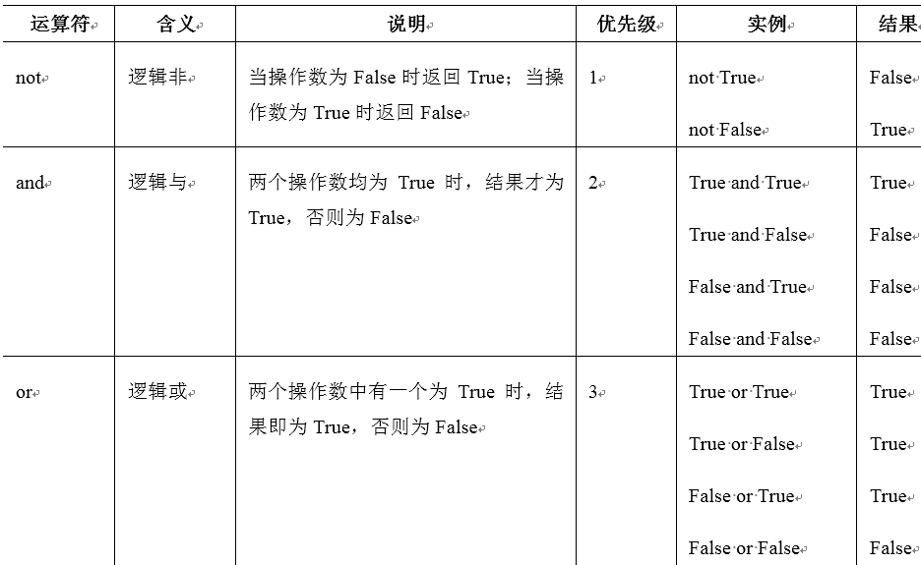
logical operator

Slide 19
arithmetic operator
operator | hidden meaning | clarification | prioritization | actual example | in the end
** | exponentiate (math.) | Multiplying powers of operands | 1 | n**3 | 512
+ | One dollar + | The value of the operand | 2 | +n | 8
- | Dollar- | inverse of an operand (math.) | 2 | -n | -8
* | subtraction | product of operands (math.) | 3 | n*n*2 | 128
/ | division (math.) | The second operand divides the first operand | 3 | 10 / n | 1.25
// | divide integers into whole numbers | Divide two integers and the result is a whole number. | 3 | 10 // n | 1
% | modulus | The remainder of the second operand divided by the first operand | 3 | 10 % n | 2
+ | addition | sum of two operands | 4 | 10 + n | 18
- | subtractive | Subtract the second operand from the first operand | 4 | n - 10 | -2

Slide 20
bitwise operator (computing)
operator (computing) | usage | hidden meaning | prioritization | an actual example | in the end
~ | ~op | care for sb's health by adding to it | 1 | ~0x1 | -2 (-0x2)
<< | op1<<op2 | Shift op1 left by op2 bits | 2 | 0xf0 << 4 | 3840 (0xf00)
>> | op1>>op2 | Shift op1 right by op2 bits | 2 | 0xf0 >> 4 | 15 (0xf)
& | op1&op2 | Bitwise Logic and | 3 | 0xff00 & 0xf0f0 | 61440 (0xf000)
^ | op1^op2 | Bitwise Logic Dissimilarity | 4 | 0xff00 ^ 0xf0f0 | 4080 (0xff0)
| | op1|op2 | bitwise logical or | 5 | 0xff00 | 0xf0f0 | 65520 (0xfff0)

Slide 21
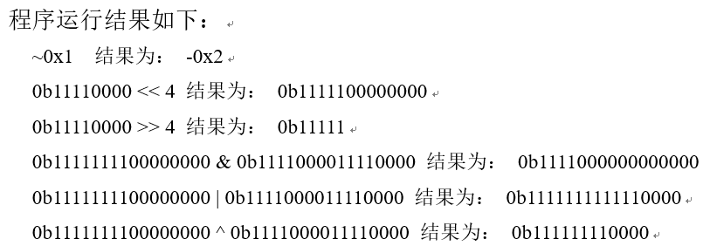
[Example 4.14] Bit Operator Example (op_bit.py)
print("~0x1 Result: ", hex(~0x1))
print("0b11110000 << 4 The result is: ", bin(0b111110000 << 4))
print("0b11110000 >> 4 The result is: ", bin(0b111110000 >> 4))
print("0b1111111100000000 & 0b111100001111110000 The result is:", bin(0b1111111100000000 & 0b111100001111110000))
print("0b1111111100000000 | 0b111100001111110000 Result: ", bin(0b1111111100000000 | 0b111100001111110000))
print("0b1111111100000000 ^ 0b111100001111110000 The result is:", bin(0b1111111100000000 ^ 0b111100001111110000))

Slide 22
Mixed operations and numeric type conversions
Mixed operations and implicit conversions
int, float and complex objects can be mixed.
If the expression contains a complex object, the other objects are automatically converted (implicitly) to complex objects, and the result is a complex object
If the expression contains a float object, the other objects are automatically converted (implicitly) to float objects, and the result is a float object
Explicit conversion (forced conversion)
Use target-type(value) to force conversion of an expression to the desired data type

Slide 23
Type Conversion Example
Example 4.15] Implicit Type Conversion Example
[Example 4.16] Explicit Type Conversion Example
>>> f = 123 + 1.23
>>> f # Output: 124.23
>>> type(f) #Output: <class 'float'>
>>> 123 + True #True converted to 1. Output: 124
>>> 123 + False #False is converted to 0. Output: 123.
>>> int(1.23) #Output: 1
>>> float(10) #Output: 10.0
>>> bool("abc") #Output: True
>>> float("123xyz") #Error. valueError: could not convert string to float: '123xyz'

Slide 24
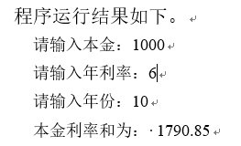
Example 4.17: Numeric Data Type Example (profit.py): Calculating Compound Interest
nb = float(input("Please enter the principal:")) #Enter the principal and convert it to a float number
nr = float(input("Please enter the APR:")) #Input the APR and convert to a float number
ny = int(input("Please enter the year:")) # Enter the year and convert to an integer
amount = nb * (1+nr/100) ** ny #calculate compound interest
print("The sum of the principal interest rates is: %0.2f"%amount) #Output compound interest, retain two decimals

Slide 25
Built-in standard math functions
function (math.) | hidden meaning | an actual example | in the end
abs(x) | The absolute value of the value x. If x is a complex number, return the modulus of x | abs(-1.2) abs(1-2j) | 1.2 2.23606797749979
divmod(a,b) | Returns the quotient and remainder of a divided by b | divmod(5,3) | (1, 2)
pow(x, y[, z]) | Returns x to the yth power (x**y). If z is specified, it is: pow(x, y) % z | pow(2,10) pow(2,10,10) | 1024 4
round(number[, ndigits]) | Rounding to the nearest whole number. If ndigits is specified, ndigits decimals are retained | round(3.14159) round(3.14159,4) | 3 3.1416
sum(iterable[, start]) | look for a draw (chess) | sum((1, 2, 3)) sum((1, 2, 3), 44) | 6 50

Slide 26
Number Conversion Functions
function (math.) | clarification | typical example
bin(number) | Numeric to binary string conversion | bin(100) #Result: '0b1100100'
hex(number) | Numeric values converted to hexadecimal strings | hex(100) #Result: '0x64'
oct(number) | Numeric Conversion to Octal Strings | oct(100) #Result: '0o144'

Slide 27
math modules and math functions
The Python standard module, math, provides many commonly used math functions, including trigonometric, logarithmic, and other general-purpose math functions.
Functions in the math module do not support complex numbers; complex number functions are located in the cmath module
The math module contains constants and functions with APIs as shown in Table 4-14(1) to (6)

Slide 28
Constants and functions included in the math module (1)
Table 4-14 (1) Constants and Functions for math (I): constants
name (of a thing) | clarification | typical example | in the end
e | The mathematical constant e | e | 2.718281828459045
pi | The mathematical constant pi | pi | 3.141592653589793

Slide 29
Constants and functions included in the math module (2)
Table 4-14 (2) Constants and Functions for math (II): numerical operations and representations
name (of a thing) | clarification | typical example | in the end
ceil(x) | Returns the smallest integer >= x | ceil(1.2), ceil(-1.6) | 2, -1
copysign(x, y) | Returns the value of x with symbol y | copysign(1.0, -0.0) | -1.0
fabs(x) | Returns the absolute value of x | fabs(-1.2) | 1.2
factorial(x) | Returns the factorial of a positive integer x | factorial(10) | 3628800
floor(x) | Returns the largest integer <= x | floor(1.8), floor(-2.1) | 1, -3
fmod(x, y) | Returns x % y | fmod(5, 3) | 2.0
frexp(x) | Return (m, e) such that: x == m * 2**e | frexp(1024) | (0.5, 11)
fsum(iterable) | Returns the sum of a sequence. Floating point numbers are more precise than sum. | fsum([.1, .1, .1, .1, .1, .1, .1, .1, .1, .1, .1]) sum([.1, .1, .1, .1, .1, .1, .1, .1, .1, .1, .1]) | 1.0 0.99999999999999999999
isfinite(x) | Determine if x is a finite value | isfinite(float('Infinity')) isfinite(float('-Infinity')) isfinite(float('NaN')) isfinite(float('12.3')) | False False False True
isinf(x) | Determine if x is infinity | isinf(float('Infinity')) isinf(12.3) | True False
isnan(x) | Determine if x is a non-numeric value | isnan(float('NaN')) isnan(12.3) | True False
ldexp(x, i) | Return x * (2**i) is the inverse function of frexp(x) | ldexp(2, 10) | 2048.0
modf(x) | Returns the fractional and integer parts of x, resulting in a tuple | modf(-12.3) | (-0.3000000000000007, -12.0)
trunc(x) | Truncate x to the closest integer to 0 | trunc(1.2) trunc(-2.8) | 1 -2

Slide 30
Constants and functions included in the math module (3)
Table 4-14(3) Constants and Functions for math (III): power and logarithmic operations
name | clarification | typical example | in the end
exp(x) | Return e ** x | exp(5) | 148.4131591025766
expm1(x) | Return e ** x - 1 is more precise than exp(x) - 1 | expm1(1e-5) exp(1e-5) - 1 | 1.0000050000166667e-05 1.0000050000069649e-05
log(x) log(x, base]) | return log_{e}x return log_{base}x | log(e) log(e, 2) | 1.0 1.4426950408889634
log1p(x) | Returns log(1+x) | log1p(1) log(2) | 0.6931471805599453 0.6931471805599453
log2(x) | return log₂x | log2(e) | 1.4426950408889634
log10(x) | return log₁₀x | log10(100) | 2.0
pow(x, y) | return x^{y}，i.e. x ** y | pow(2,8) | 256.0

Slide 31
Constants and functions included in the math module (4)
Table 4-14 (4) Constants and Functions of math (IV): trigonometric functions
name (of a thing) | clarification | typical example | in the end
acos(x) | Returns the inverse cosine of x | acos(1) | 0.0
asin(x) | Returns the arcsine of x | asin(1) | 1.5707963267948966
atan(x) | Returns the arctangent of x | atan(1) | 0.7853981633974483
atan2(y, x) | Returns atan(y/x) for x | atan2(1, 2) | 0.4636476090008061
cos(x) | Returns the cosine of x | cos(2*pi) | 1.0
hypot(x, y) | Return sqrt(x*x + y*y), the Euclidean distance | hypot(3,4) | 5.0
sin(x) | Returns the sine of x | sin(pi/2) | 1.0
tan(x) | Returns the tangent of x | tan(pi/4) | 0.99999999999999999999

Slide 32
Constants and functions included in the math module (5)
Table 4-14 (5) Constants and Functions for math (V): hyperbolic functions
name (of a thing) | clarification | typical example | in the end
acosh(x) | Return the hyperbolic inverse cosine of x | acosh(1) | 0.0
asinh(x) | Returns the hyperbolic arcsine of x | asinh(1) | 0.8813735870195429
atanh(x) | Return the hyperbolic secant of x | atanh(0.1) | 0.1003353477310756
cosh(x) | Returns the hyperbolic cosine of x | cosh(1) | 1.5430806348152437
sinh(x) | Returns the hyperbolic sine of x | sinh(0.1) | 0.10016675001984403
tanh(x) | Returns the hyperbolic tangent of x | tanh(0.1) | 0.09966799462495582
Table 4-14(6) Constants and Functions for math (VI): Angle Radian Conversion Functions
name (of a thing) | clarification | typical example | in the end
degrees(x) | Convert x from radians to angles | degrees(pi) | 180.0
radians(x) | Convert x from angle to radian | radians(90) | 1.5707963267948966

Slide 33
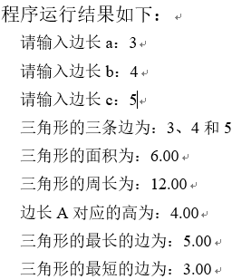
Examples of math module applications (1)
import math
#三角形三边a、b、c，必须满足：三条边长均大于零，并且任意两边之和大于第三边
a=int(input("请输入边长a："))
b=int(input("请输入边长b："))
c=int(input("请输入边长c："))
if (a>0 and b>0 and c>0 and a+b>c and a+c>b and b+c>a):
h = (a + b + c) / 2 #周长的一半
area = math.sqrt(h * (h - a) * (h - b) * (h - c)) #面积
perimeter = a + b + c #周长
height_a = 2 * area / a #边长a所对应的高
max_side = max(a, b, c) #最长边长
min_side = min(a, b, c) #最短边长
print("三角形的三条边为：{0}、{1}和{2}".format(a, b, c))
print("三角形的面积为：{0:.2f}".format(area))
print("三角形的周长为：{0:.2f}".format(perimeter))
print("边长A对应的高为：{0:.2f}".format(height_a))
print("三角形的最长的边为：{0:.2f}".format(max_side))
print("三角形的最短的边为：{0:.2f}".format(min_side))
else:
print("三条边：{0}、{1}和{2}，不能构成三角形".format(a, b, c))
[Example 4.18] Example of the use of math functions (math_test.py):
input three side lengths,determine whether a triangle can be formed

Slide 34

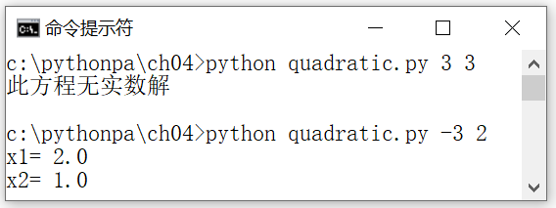
Examples of math module applications (2)
Example 4.19: Example of using a math function (quadratic.py): Find a real number solution to a quadratic equation.
import math
import sys
b = float(sys.argv[1])
c = float(sys.argv[2])
discriminant = b*b - 4.0*c
if discriminant>=0.
d = math.sqrt(discriminant)
print("x1=",(-b + d) / 2.0)
print("x2=",(-b - d) / 2.0)
else.
print("This equation has no real solutions.")

Slide 35

The random module and random functions
The random module contains a variety of pseudo-random number generating functions, as well as a variety of functions for generating random numbers based on probability distributions.
The seed of the pseudo-random number generator can be set using the random module function seed().
>>> import random
>>> random.seed(1) #set the seed to 1
>>> for i in range(5): print(random.randint(1,5),end=',') #output: 2,5,1,3,1,
>>> for i in range(5): print(random.randint(1,5),end=',') #Output: 4,4,4,4,4,2,
>>> random.seed(1) #reset seed to 1, result repeats
>>> for i in range(5): print(random.randint(1,5),end=',') #output: 2,5,1,3,1,
>>> random.seed(10) #reset seed to 10
>>> for i in range(5): print(random.randint(1,5),end=',') #Output: 5,1,4,4,5,

Slide 36
The random module and random functions
random integer
name (of a thing) | clarification | typical example | Results (randomized)
randrange(stop) | Returns a random integer N, N belongs to the sequence [0, stop) | for i in range(10): print(randrange(10),end=',') | 8,6,7,4,0,9,1,5,4,9.
randrange(start, stop[, step]) | Returns a random integer N which belongs to the sequence [start, stop, step) | for i in range(10): print(randrange(1,5),end=',') | 3,4,1,2,3,4,4,4,1,1.
randint(a, b) | Returns a random integer N such that a<=N<=b, i.e. randrange(a, b+1) | for i in range(10): print(randint(1,5),end=',') | 1,2,5,5,1,1,1,2,3,4.
getrandbits(k) | Returns a random integer N such that the bit length of N is k | for i in range(10): print(getrandbits (2),end=',') | 0,0,1,2,1,3,1,1,1,1,1.

Slide 37
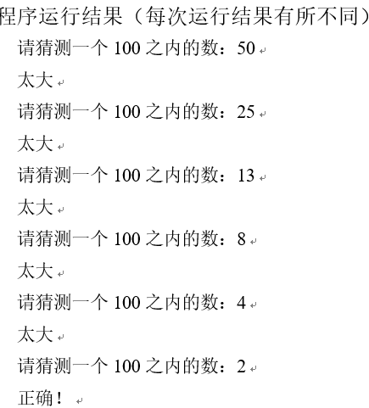
[Example 4.20] Guess the Number Game (guess.py)
First, a random integer within 1~100 is generated and the user is asked to guess which number it is, i.e., the user's guess is constantly read from the standard input and a prompt is given based on the guess: "Too big", "Too small" or "Correct!"
import random
secret = random.randrange(1, 101)
guess = 0
while guess ! = secret.
guess = int(input("Please guess a number within 100:"))
if (guess < secret): print('too small')
elif (guess > secret): print('too big')
else: print('Correct!')

Slide 38
Random Series
The examples in the hypothetical table are based on the following prerequisites:
>>> from random import *
>>> seq=('a','e','i','o','u'); seq1 = [1, 2, 3, 4, 5]
name (of a thing) | clarification | typical example | Results (randomized)
choice(seq) | Return a random element from a non-empty sequence seq | for i in range(5): print(choice(seq),end=',') | e, e, e, a, e.
sample(population, k) | Randomly draw k elements from the non-empty sequence population and return its list | sample(seq,3) | ['i', 'u', 'a']
shuffle(x[, random]) | Mixed list. The optional random is a random function, the default is random() | shuffle(seq1);seq1 | [2, 1, 5, 3, 4]
[Example 4.21] Mixed Arrangement Example (random_shuffle.py): Randomly generating four hands of poker (4-person hand, 13 cards per hand) ......to be continued

Slide 39
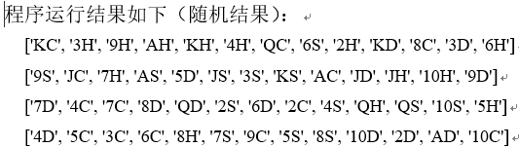
[Example 4.21] Mixed Arrangement Example (random_shuffle.py)
import random
#Deck: Clubs, Diamonds, Hearts, Spades, 2-10, J, Q, K, A
cards = ['2C','3C','4C','5C','6C','7C','8C','9C','10C','JC','QC','KC','AC'.
'2D', '3D', '4D', '5D', '6D', '7D', '8D', '9D', '10D', 'JD', 'QD', 'KD', 'AD'.
'2H', '3H', '4H', '5H', '6H', '7H', '8H', '9H', '10H', 'JH', 'QH', 'KH', 'AH'.
'2S', '3S', '4S', '5S', '6S', '7S', '8S', '9S', '10S', 'JS', 'QS', 'KS', 'AS']
random.shuffle(cards) #mix, shuffle cards
deck1=[];deck2=[];deck3=[];deck4=[] #initialize four hands
for i in range(13): #deal cards
deck1.append(cards.pop())
deck2.append(cards.pop())
deck3.append(cards.pop())
deck4.append(cards.pop())
print(deck1);print(deck2);print(deck3);print(deck4)

Slide 40
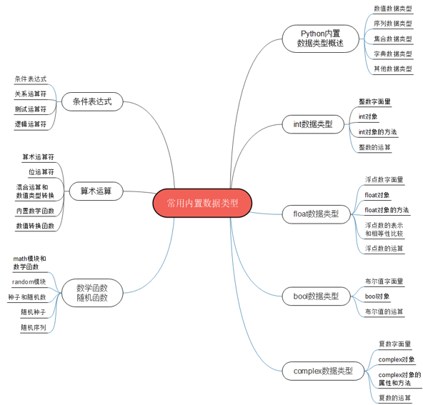
Summary of the chapter

Slide 41
Examples of integrated applications
Monte Carlo simulation: the fate of gamblers going broke
The ultimate fate of a gambler is bankruptcy: suppose a gambler starts with a given betting chip and places a series of successive 1-chip bets, with the end result that the gambler is doomed to lose it all.
The hypothesis can be proved by stochastic simulation, assuming that the initial stake is stake one chip, and each time a bet is placed, the winner is determined by the random numbers 0 and 1: the chip is added to 1 when 0, subtracted from 1 when 1, and terminated when the chip is less than 0. Simulation trials take the average number of bets placed
[Example 4.22] Gambler's Fate of Bankruptcy (gambler1.py)
Running the program results in a different outcome each time, but eventually it finishes and outputs the number of times it takes to go bankrupt. Note that if the number of takes is large, the program may take longer to run...to be continued
[Example 4.23] Probability of a gambler winning (gambler2.py)
... to be continued

Slide 42
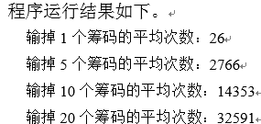
[Example 4.22] Gambler's Fate of Bankruptcy (gambler1.py)
import random
def gamble(stake, trials).
"""Returns the number of times it takes to lose the take, averaged over simulation trials.""""
total_bets = 0 #Total number of bets placed
max_cash = stake #maximum stake
for t in range(trials):# simulate averaging trials times
cash = stake #chips
while cash > 0: # Keep betting until you're broke
# Simulate a bet
total_bets += 1
if random.randrange(0, 2) == 0.
cash += 1
max_cash = max(max_cash, cash)
else: cash -= 1
#print(cash)
#print("Maximum stake during gambling = {}".format(max_cash))
return int(total_bets/trials)
if __name__ == "__main__".
print("Average number of chips lost {}: {}".format(1,gamble(1,100)))
print("Average number of chips lost {}: {}".format(5,gamble(5,100)))
print("Average number of chips lost {}: {}".format(10,gamble(10,100)))
print("Average number of chips lost {}: {}".format(20,gamble(20,100)))

Slide 43
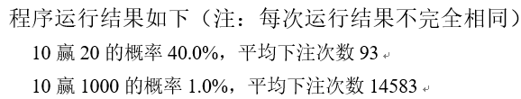
[Example 4.23] Probability of a gambler winning (gambler2.py)
import random
def gamble(stake, goal, trials).
"""Returns the number of times it takes to lose the take, averaged over simulation trials.""""
bets = 0 # total number of bets placed
wins = 0 #Number of wins
for t in range(trials):# simulate averaging trials times
cash = stake #chips
# Keep betting until you're broke, or reach your target exit
while cash > 0 and cash < goal.
# Simulate a bet
bets += 1
if random.randrange(0, 2) == 0.
cash += 1
else: cash -= 1
if cash >= goal: wins += 1 #number of wins
return wins/trials, int(bets/trials)
if __name__ == "__main__".
p, n = gamble(10,20,100)
print("{} probability of winning {} {}%, average number of bets {}".format(10,20,p*100,n))
p, n = gamble(10,1000,100)
print("{} probability of winning {} {}%, average number of bets {}".format(10,1000,p*100,n))

Slide 44
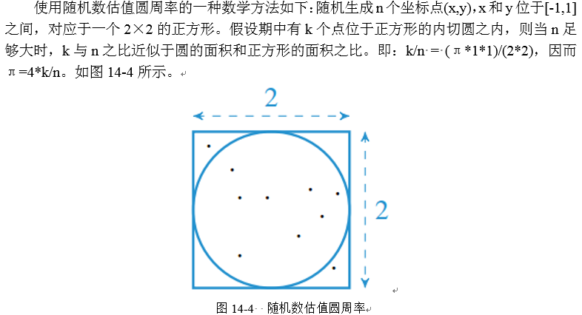
Valuing pi using random numbers
A mathematical method for valuing circumference using random numbers is as follows:
Randomly generate n coordinate points (x,y), with x and y lying between [-1,1], corresponding to a 2 × 2 square, as shown in Figure 4-11. Assuming that k of these points lie within the tangent circle of the square, the ratio of k to n approximates the ratio of the area of the circle to the area of the square when n is sufficiently large. That is, kn = (T*1*1)/(2*2), and thus i = 4*k/n.

Slide 45
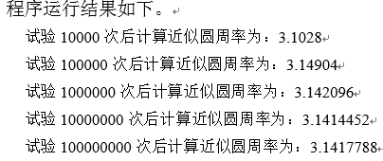
[Example 4.24] Using Random Numbers to Value Circumference (piRandom.py)
import random
def pi(trials).
"""Approximating circumference pi by random point locations""""
hits = 0 #Number of points that hit the circle
for i in range(trials):
x = random.uniform(-1,1) # randomly generate x coordinates between -1 and 1
y = random.uniform(-1,1) # randomly generate y coordinates between -1 and 1
if x**2+y**2 <= 1: # add 1 to the number of hits if inside the circle
hits += 1
return 4*hits/trials
# Test code
if __name__ == "__main__".
for i in range(5):
n = 10000*(10**i)
print("The approximate pi is calculated after {} trials as: {}".format(n, pi(n)))

Slide 46
Case study: scientific computing and data analysis
As the Python language ecosystem improves, numerous scientific computing and data analysis libraries (e.g., NumPy, SciPy, Pandas, Matplotlib, IPython, etc.) make Python the language of choice for scientific computing and data analysis
The case studies in this chapter guide the reader through the door of scientific computing with a few simple application examples
The solution and source code etc. of the case studies are provided in electronic format, please scan the QR code in the tutorial for details

Slide 47
Example CS4.1] Jupyter Notebook Example of Use
(1) Execute the Windows menu command "Start" | "All Apps" | Anaconda3(64-bit) | Jupyter Notebook, start the local server, and open the homepage in the default browser.
(2) Create a new Notebook file. Click the "New" drop-down menu in Figure CS-20, select Python 3, and create a new Notebook named Untitled.
(3) Enter Markdown text. In the first cell input box, type "Scientific Computing with IPython Notebook" and set the cell type to Markdown.

Slide 48
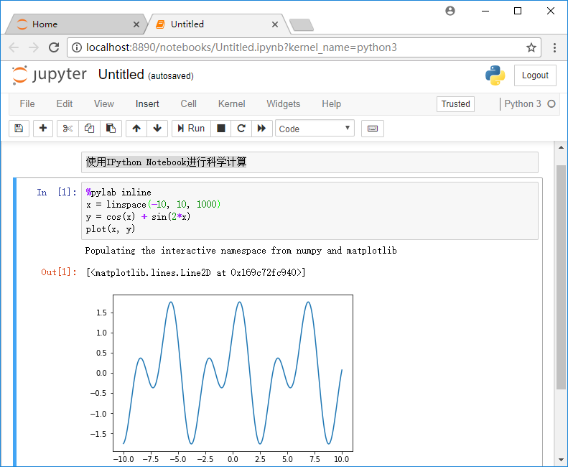
Example CS4.1: Jupyter Notebook Example of Use
(4) Enter and execute Python code. Use the menu command Insert|Insert Cell Below or shortcut key B, insert a cell below, enter the code, press the shortcut key Ctrl + Enter, execution and display the results

Slide 49
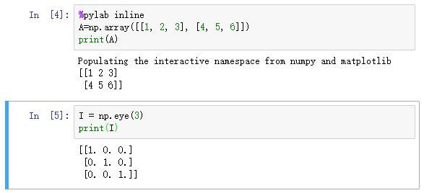
Example CS4.2: Creating Vectors and Matrices (Arrays)

Slide 50
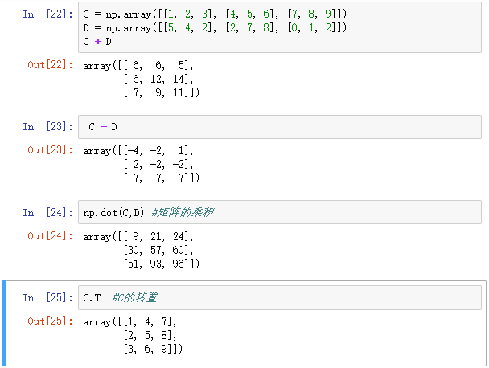
Example CS4.3: Matrix Operations

Slide 51
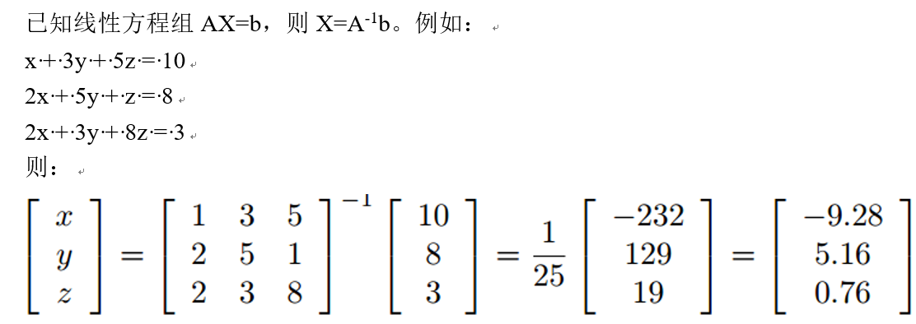
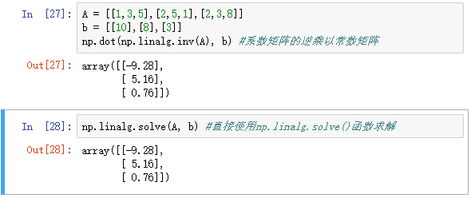
[Example CS4.4] Solving Systems of Linear Equations

Slide 52
Thank!

